Slide 1
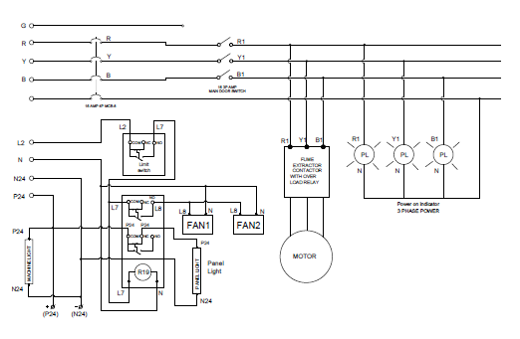
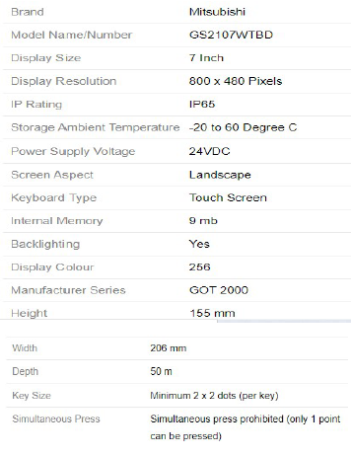
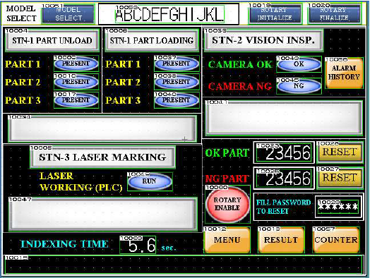
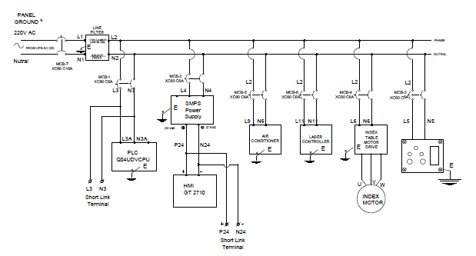


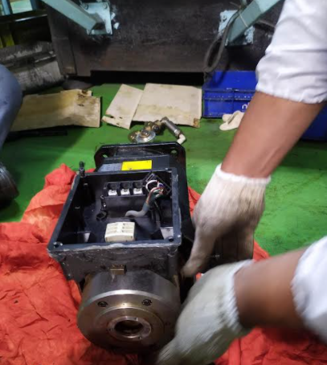
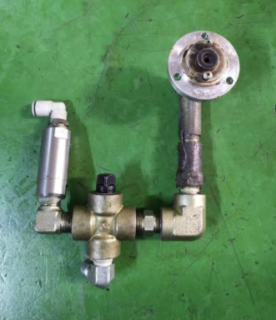
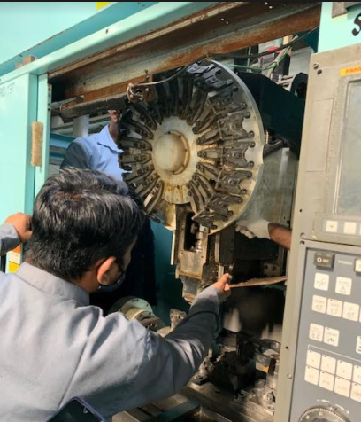
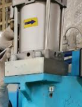



Steel Phase Laser marking machine Component Level Training
Laser Marking machine -Control system
Electrical Circuit of Laser marking machine
Understanding & Checking Of Laser marking parameter (GOT2000)
Understanding of laser marking process and its device connected
Check points
S o. | CHECK ITEM | CHECK CONTENTS | JUDGEMENT METHOD | STANDARD | CHECKING METHOD
1. | LASER UNIT MOUNING | LOOSE | CLEAN | CLEAN & TIGHT | TIGHTNED THE MOUTING WITH SPANNER
2. | MOTOR CABLES & CONNECTER | LOOSE & DAMAGED | TIGHT & NO DAMAGE | PULL THE CABLE & CHECK THE GLAND | BY HAND/ BY EYE
3. | PLC | MOUNTING LOOSE CONECTION LOOSE | TIGHT & NO DAMAGE | VISUAL | TIGHTNED THE MOUNTUNG WITH SCREW DRIVER
4. | SAFETY INTERLOCK | BYPASSED | ONLINE | MANUAL | CHECKING ALL INTERLOCKS
M/c Standard Check points covered :
Equip. Std. Check Point | TBM Point | CBM Point | Total Points
 | 02 Nos. | 02 Nos. | 04 Nos

